Slide 1
SEARCHING FOR A PROTEIN
1
2
Organism
Gene Name or Uniprot Accession
Search
Mouse
Human
1
Human FASTA
2
x
x
3
1
Human Cell data
x
3
2

Slide 2

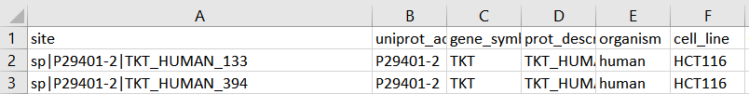

After clicking search (previous slide) this chart will popup on the left
1
3
Human
2
.
.
.
C7
C6
C5
C4
C3
C2
C1
Engaged cysteine (R > 2)
Amino acid sequence
Mapped cysteine
Unmapped cysteine
4
2
Every “C” in the string and their positions
Human FASTA
3
These numbers show mapped cysteine. The rest of the C’s in the respective string in (2) are unmapped cysteines
Human cell data
4
3
Pick the highest R-value from C1-C14. If that R > 2 → changed mapped cysteine to engaged cysteine

